Slide 1

AI
Heart Attack Risk Prediction Using Artificial Neural Network
Group 4
1. Adli Hakim Zulkifli (2110959)
2. ⁠⁠Muhammad Nazim Bin Akhmar (2114551)
3. ⁠Tashfin Muqtasid (2119609)
4. ⁠Norhezry Hakimie bin Noor Fahmy (2110061)

Slide 2
INTRODUCTION
Heart diseases can be predicted by looking at a person’s various health factors.
We can use a Deep Learning Neural Network model to predict the risk of heart disease by recognizing health patterns.
Why Did We Choose ANN?
Pattern Recognition: ANNs excel at recognizing patterns within complex datasets.
Feature Extraction: ANNs can automatically extract relevant features from raw data.
Scalability: ANNs can scale effectively to handle large and diverse datasets.
Continuous Learning: ANNs can continuously learn and adapt to new information, making them suitable for dynamic environments such as healthcare.

Slide 3
3 Approaches we took:
Coding a Neural Network from scratch using Numpy
Building a model using Tensorflow Keras and training it using a Genetic Algorithm to determine the optimum number of neurons per layer
Testing the model on a different dataset

Slide 4
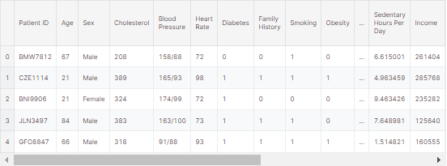
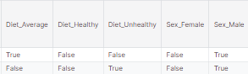
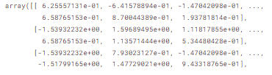
Data Pre-Processing
Before we can train a deep learning model, we need to clean the data.
Cleaned the data by dropping irrelevant features such as Patient ID , Continent, etc.
Used OneHotEncoding to convert categorical data such as Diet and Sex to numerical data
Normalized the data using sklearn library with this equation: z=x−μ/σ
Split the data into a training set and validation/testing set

Slide 5
1st Approach
Building a basic Neural Network using Numpy

Slide 6
Building the Model
Activation function
Built using numpy from scratch
1 Input Layer,
3 HiddenLayer,
1 Output layer
we coded using numpy
divided into several functions
compiled together at the end to create a functional model.
ReLu, ReLu,ReLu, Sigmoid
Loss Function
compute_cost() function
which computes the loss using Binary Crossentropy.

Slide 7
Layer
No of Neuron
Activation Function
1
Input : 24 neurons
no activation function
2
Hidden Layer 1: 32 neurons
ReLu
3
Hidden Layer 2: 16 neurons
ReLu
speed up learning
4
Hidden Layer 3: 8 neurons
ReLu
5
Output: 1 neuron
Sigmoid
the best choice for binary classification.
Use dense layer to connect each neurons

Slide 8
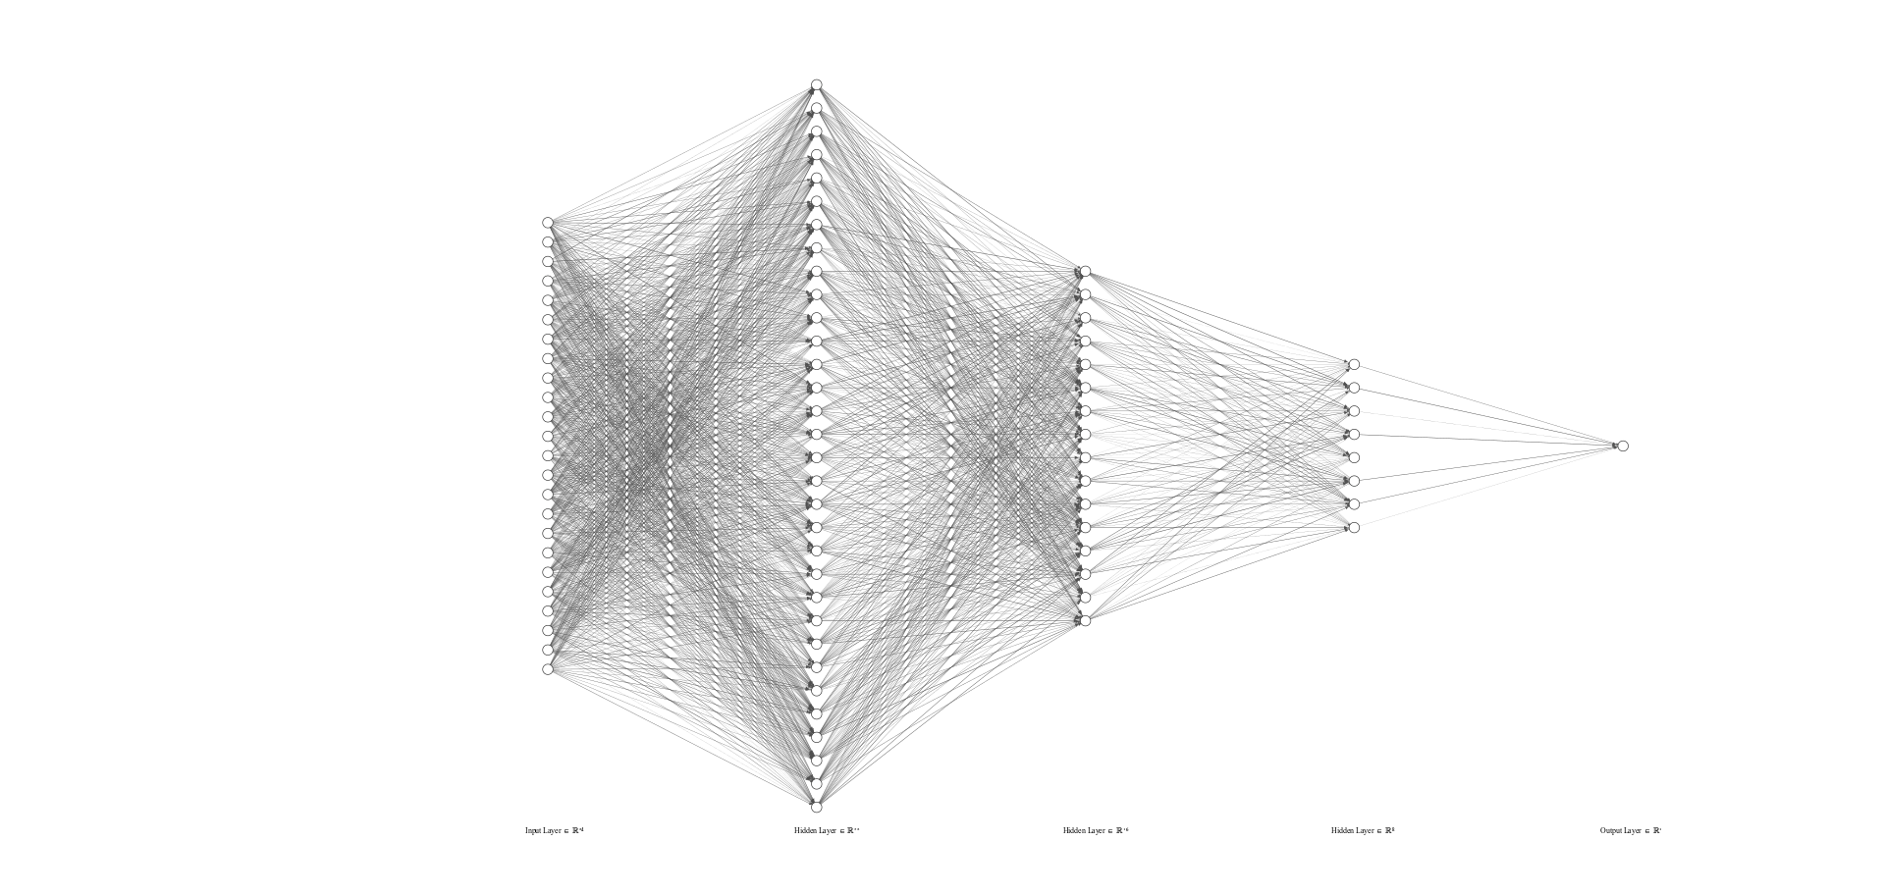
Input
Hidden 1
Hidden 2
Hidden 3
Output
ReLu
ReLu
Relu
Sigmoid

Slide 9
Code (Full Code in Report)
Functions used in code:
sigmoid: Computes the sigmoid.
relu: Computes the ReLU.
relu_backward: Implements the backward propagation for a single ReLU unit.
sigmoid_backward: Implements the backward propagation for a single sigmoid unit.
initialize_parameters_deep: Initializes the parameters of a deep neural network.
linear_forward: Implements the linear part of a layer's forward propagation.
linear_activation_forward: Implements the forward propagation for the linear -> activation layer.
L_model_forward: Implements forward propagation for the entire network.
compute_cost: Computes the cost function (cross-entropy cost).
linear_backward: Implements the linear portion of backward propagation for a single layer.
linear_activation_backward: Implements the backward propagation for the linear -> activation layer.
L_model_backward: Implements the backward propagation for the entire network.
update_parameters: Updates parameters using gradient descent.
L_layer_model: Implements a L-layer neural network. L is the number of layers defined by the user.
predict: Predicts the results of a L-layer neural network.
plot_costs: Plots the learning curve.

Slide 10
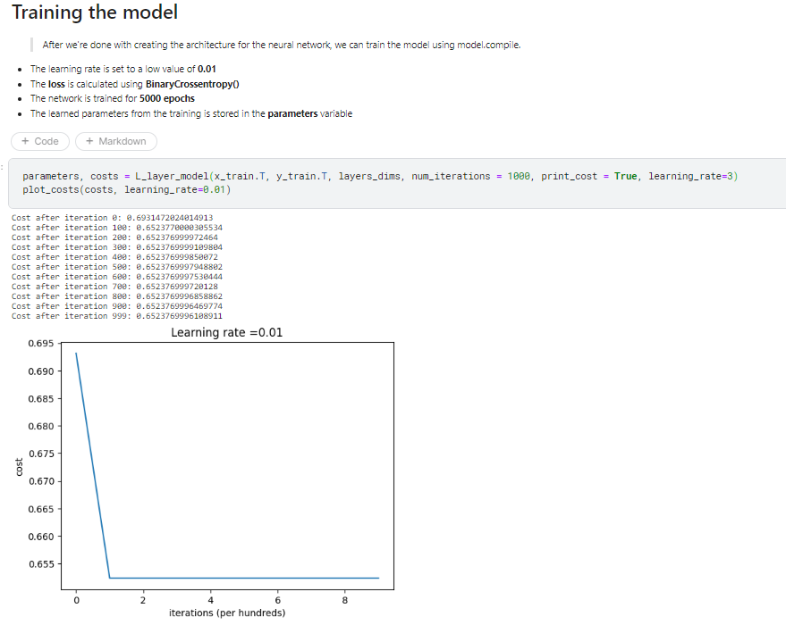
Training the Model
Learning rate is set as low as 0.1
The loss is calculated using BinaryCrossentropy()
The network is trained for 1000 epochs
cost function stops decreasing after a few epochs (vanishing gradient)
Epochs-when all the training data is used at once

Slide 11
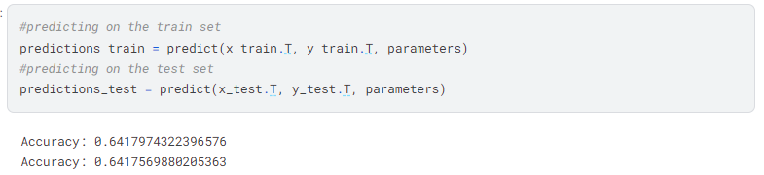
PREDICTING USING THE MODEL
Talk about the results
The accuracy when the model is predicts the data is about 0.6417569880205363
Which is just almost 65% of accuracy

Slide 12
2nd Approach
Building a Neural Network using TensorFlow and training using GA

Slide 13
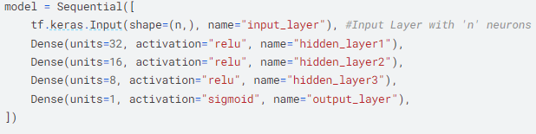

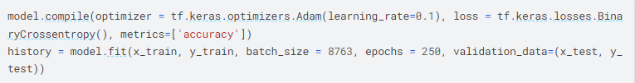
Alternative approach using TensorFlow
Same model built using TensorFlow, ran for 250 epochs
Used Adam optimiser which makes use of momentum to smooth out gradient descent

Slide 14
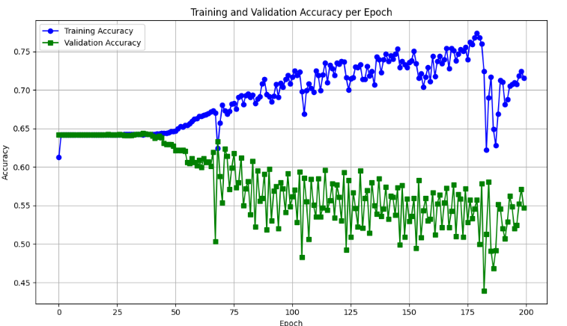
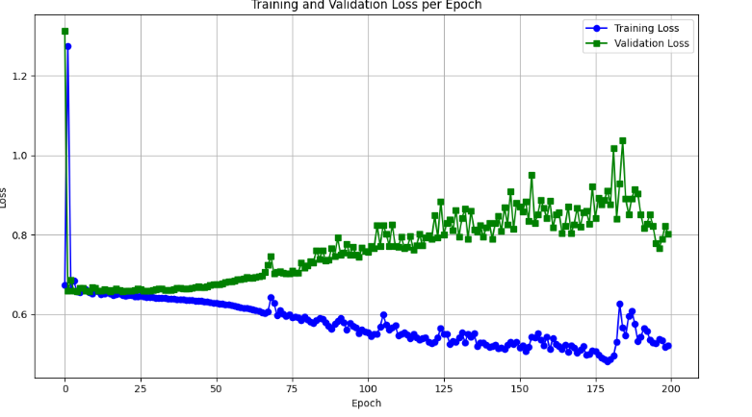
Result Using Tensorflow
Overfitting, Doesn’t generalise
Similiar accuracy until about 48 epochs, after which the model overfits to the training set

Slide 15
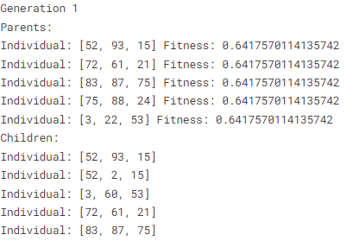
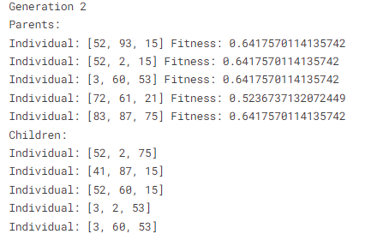
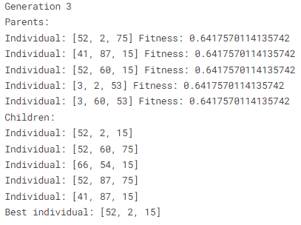
Training Using GA
Used Genetic Algorithm to find the optimum number of neurons per hidden layer in the TensorFlow model
Maximization operation where the fitness value is the model accuracy
Population = 5, Gmax = 3, Pc = 0.8, Pm = 0.2

Slide 16
3rd Approach
Training the Tensorflow network on a different dataset

Slide 17
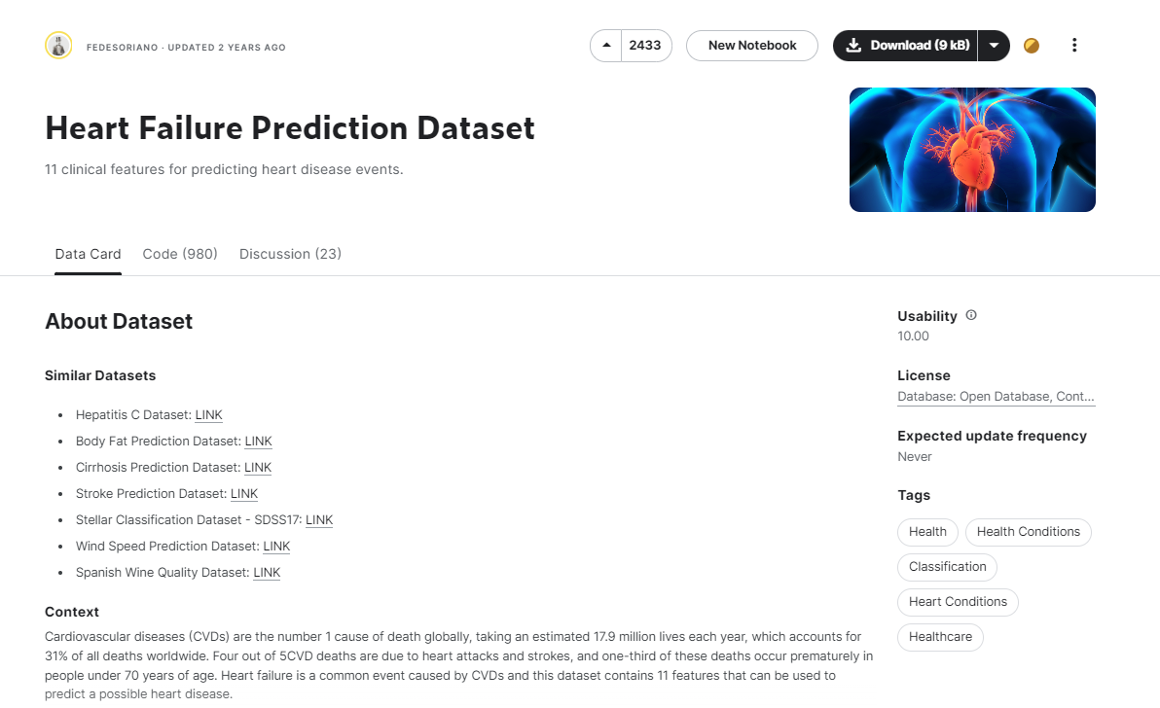
Model trained on different dataset
Since the model didn’t perform very well on the given dataset, we tested it on another dataset: https://www.kaggle.com/datasets/fedesoriano/heart-failure-prediction
This dataset has different features compared to the first one, so we had to do some pre-processing.
The same neural network model is used (with same number of layers, neurons etc.)

Slide 18
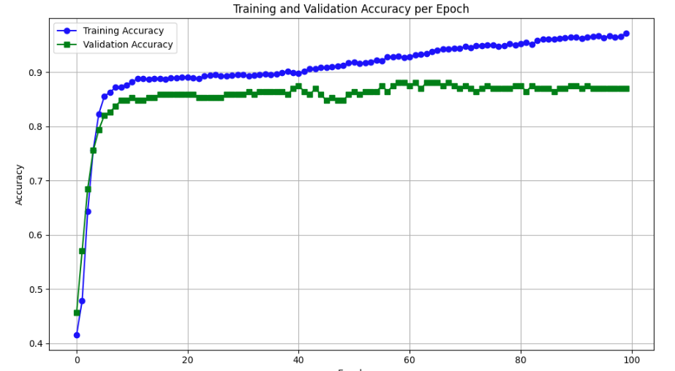
Results on alternative dataset
vs
Accuracy per epoch of the new data
Accuracy per epoch of previous data
The accuracy of both the training set and the validation set in the new model increases per epoch, unlike the first dataset.
The accuracy of the new model is almost 90%
The new model starts overfitting after about 40 epochs after which only the training set accuracy increases

Slide 19
Conclusion
The model performed well on the alternative dataset but poorly on the given dataset.
The first dataset is made using ChatGPT and does not reflect the real world, hence there is no discernable pattern for the neural network to learn.
The model can be improved by using hyperparameter tuning using Genetic Algorithm.
However, Genetic Algorithm is very computationally intensive and takes a lot of time.
To conclude, we successfully built a neural network model.
A graphical user interface can be developed using Gradio library and the app can be hosted on huggingface.co/spaces

Slide 20

Q&A

